Slide 1
Data Science: A Game-Changer in the Space Race
REPORTED BY: I.V.SRICHANDRA

Slide 2
OUTLINE
Executive Summary
Introduction
Methodology
Results
Conclusion
Appendix

Slide 3
SUMMARY
Summary of methodologies
Data Collection through API
Data Collection with Web Scraping
Data Wrangling
Exploratory Data Analysis with SQL
Exploratory Data Analysis with Data Visualization
Interactive Visual Analytics with Folium
Machine Learning Prediction
Summary of all results
Exploratory Data Analysis result
Interactive analytics in screenshots
Predictive Analytics result

Slide 4
Introduction
Project Overview:
The fact that Space X can reuse the first stage of the Falcon 9 rocket saves a significant amount of money; other companies charge upwards of 165 million dollars for each launch. Space X promotes Falcon 9 rocket launches on its website for 62 million dollars. Thus, the cost of a launch can be ascertained if we can ascertain if the initial stage will land. Should another business wish to compete with Space X for a rocket launch, they can use this information. In order to determine whether the initial stage will land successfully, the project aims to build a machine learning pipeline.
Problem and solution:
What aspects of the rocket's trajectory influence its successful landing?
The way different elements interact to determine how likely a landing is to be successful.
What operational circumstances must exist for the landing programme to be successful.

Slide 5
METHODOLOGY
Data Collection:
We gathered information for our analysis by using the SpaceX API and extracting data from Wikipedia through web scraping.
Data Wrangling:
To tidy up the data, we organized and cleaned it. Categorical features were converted into a format suitable for analysis through a method called one-hot encoding.
Exploratory Data Analysis (EDA):
We delved into the data, gaining insights and patterns through visualization and SQL queries. This helped us understand the structure and trends within the dataset.

Slide 6
Interactive Visual Analytics:
Utilizing tools like Folium and Plotly Dash, we created interactive visuals to enhance our understanding of spatial and dynamic aspects of the data.
Predictive Analysis:
Employing classification models, we made predictions based on the data. This involved building, fine-tuning, and evaluating the performance of these models.
Classification Model Building Process:
Build Models: We created models to categorize data.
Tune Models: Adjustments were made to optimize model performance.
Evaluate Models: We assessed the models' accuracy and effectiveness in making predictions.
Our goal was to provide a comprehensive analysis by combining data-driven insights, visual representations, and predictive modeling techniques.

Slide 7
Data Collection
The SpaceX API's get request method was used to collect data.
The response content was then decoded as JSON using the.json()
function call, and it was then converted into a pandas dataframe using the.json_normalize() function.
The data was then cleansed, any missing values were looked for, and any needed fill-ins were made.
Furthermore, using BeautifulSoup, we scraped the Wikipedia for Falcon 9 launch records.
The goal was to take the HTML table containing the launch records, parse it, and then transform it into a pandas dataframe so that it could be used for further research.

Slide 8
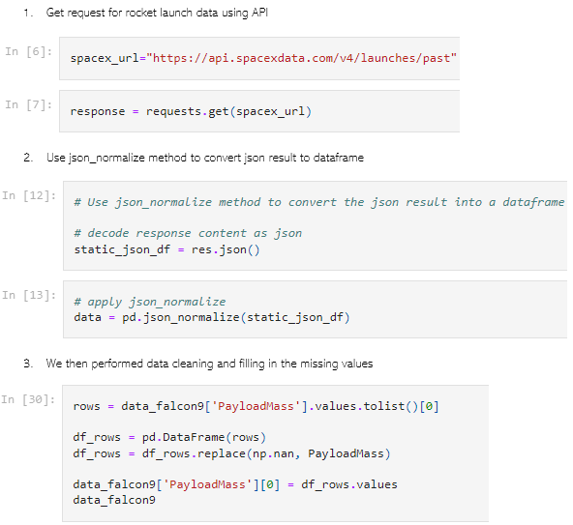
SpaceX-API
We used the get request to the SpaceX API to collect data, clean the requested data and did some basic data wrangling and formatting.

Slide 9
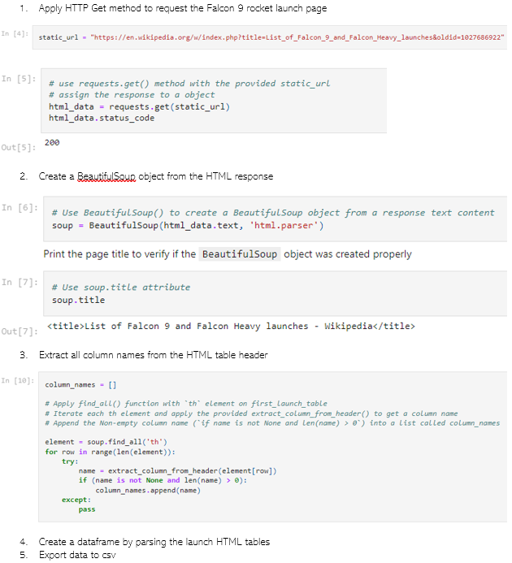
Scraping
Using BeautifulSoup, we used web scraping to gather Falcon 9 launch records.
The table was parsed, and a pandas dataframe was created.

Slide 10
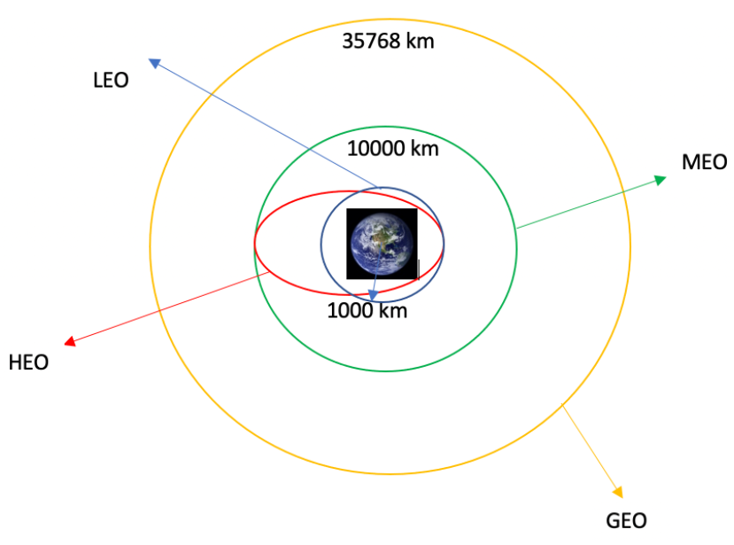
Data Wrangling
We identified the training labels by doing an exploratory data analysis.
We determined the quantity of launches at every location as well as the quantity and frequency of each orbit.
From the outcome column, we generated the landing outcome label and exported the data to CSV.

Slide 11
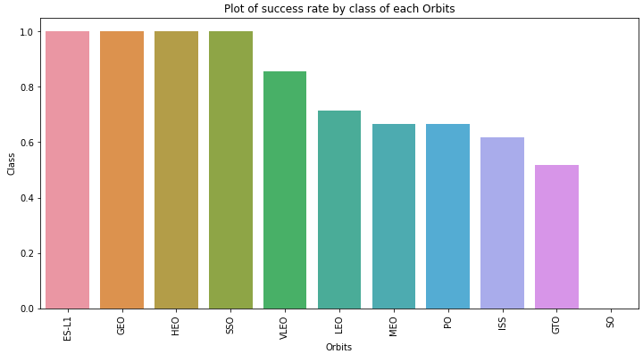
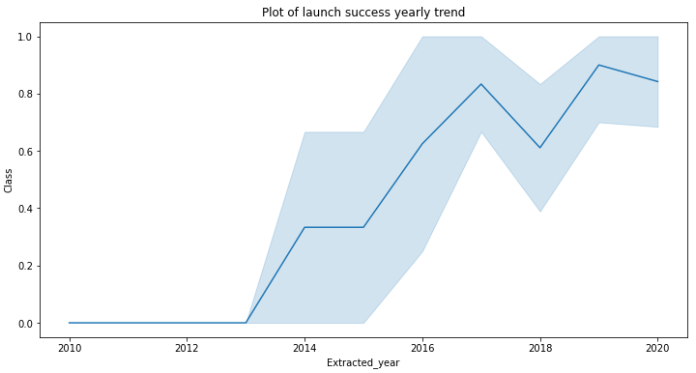
EDA With Data Visualization
The relationship between the flight number and the launch site, the payload and the launch site, the success rate of each orbit type, the flight number and the orbit type, and the annual trend of launch success were all visualised as we investigated the data.

Slide 12
EDA With SQL
The SpaceX dataset was loaded into a PostgreSQL database without requiring us to exit the Jupyter notebook.
To extract meaning from the data, we used SQL and EDA. We created queries to learn, for example:
the space mission's distinct launch sites' names.
The total mass of payload that NASA's CRS boosters have carried
The rocket version F9 v1.1's average payload mass
The overall count of mission results that were successful and unsuccessful
drone ship's unsuccessful landing results, along with the names of the launch sites and booster versions.

Slide 13
Build an Interactive Map with Folium
We marked all launch sites, and added map objects such as markers, circles, lines to mark the success or failure of launches for each site on the folium map.
We assigned the feature launch outcomes (failure or success) to class 0 and 1.i.e., 0 for failure, and 1 for success.
Using the color-labeled marker clusters, we identified which launch sites have relatively high success rate.
We calculated the distances between a launch site to its proximities. We answered some question for instance:
Are launch sites near railways, highways and coastlines.
Do launch sites keep certain distance away from cities.

Slide 14
Building DashBoard with Plotly Dash
Using Plotly dash, we created an interactive dashboard.
We created pie charts that displayed the overall number of launches made by particular websites.
We created a scatter diagram to display the correlation between the various booster versions' outcomes and payload masses (kg).

Slide 15
Predictive Analysis
Using pandas and numpy, we loaded the data, processed it, and divided it into training and testing sets.
Using GridSearchCV, we constructed several machine learning models and adjusted various hyperparameters.
Our model's accuracy served as its metric, and it was enhanced through feature engineering and algorithm tuning.
The top-performing categorization model has been identified.

Slide 16
Results
Exploratory data analysis results
Interactive analytics demo in screenshots
Predictive analysis results

Slide 17
Insights Drawn from EDA

Slide 18
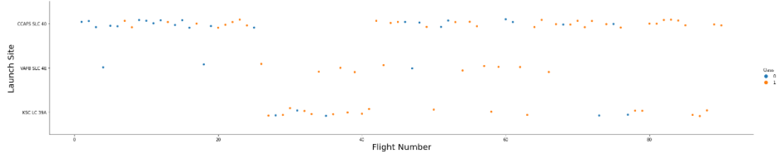
Flight Number vs Lauch Site
From the plot, we found that the larger the flight amount at a launch site, the greater the success rate at a launch site.

Slide 19

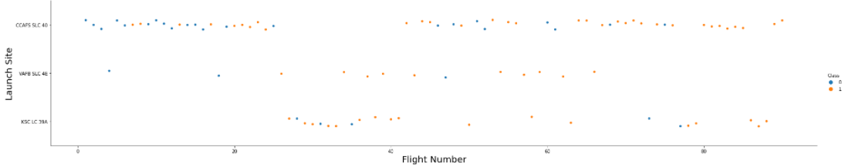
Payload vs Lauch Site

Slide 20

Success Rate vs. Orbit Type
From the plot, we can see that ES-L1, GEO, HEO, SSO, VLEO had the most success rate.

Slide 21
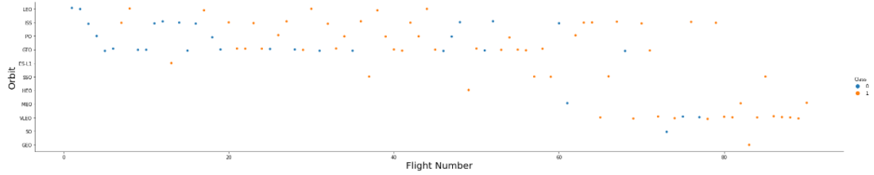
Flight Number vs. Orbit Type
The plot below shows the Flight Number vs. Orbit type. We observe that in the LEO orbit, success is related to the number of flights whereas in the GTO orbit, there is no relationship between flight number and the orbit.

Slide 22
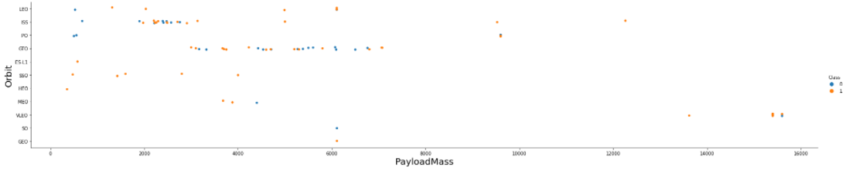
Payload vs. Orbit Type
We can observe that with heavy payloads, the successful landing are more for PO, LEO and ISS orbits.

Slide 23
Launch Success Yearly Trend
From the plot, we can observe that success rate since 2013 kept on increasing till 2020.

Slide 24
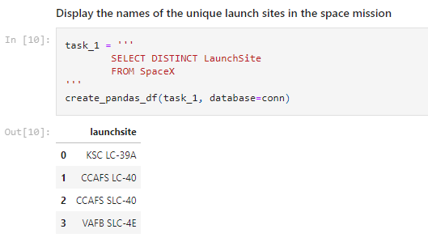
All Launch Site Names
We used the key word distinct to show only unique launch sites from the SpaceX data.

Slide 25
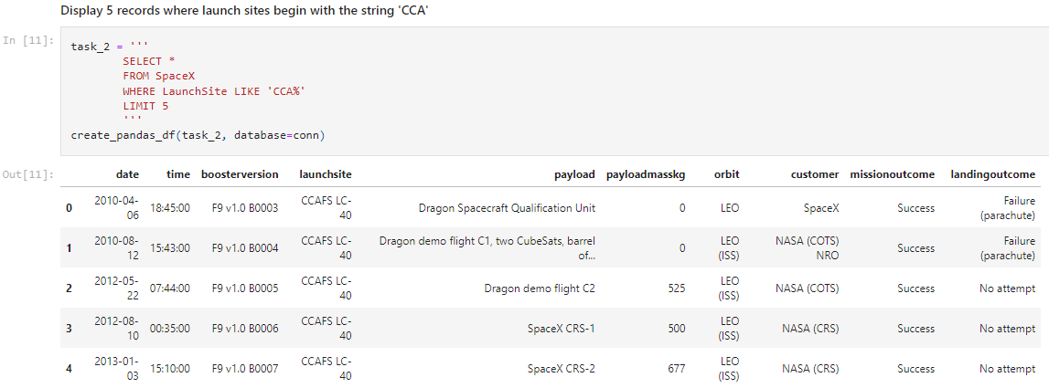
Launch Site Names Begin with 'CCA'
We used the query above to display 5 records where launch sites begin with `CCA`

Slide 26
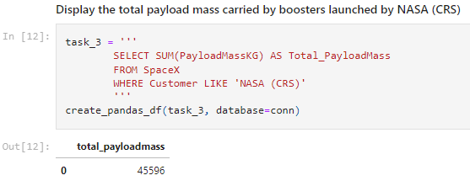
Total Payload Mass
We calculated the total payload carried by boosters from NASA as 45596 using the query below

Slide 27
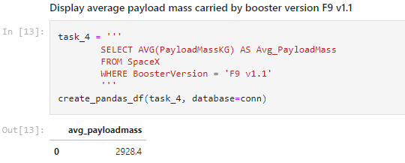
Average Payload Mass by F9 v1.1
We calculated the average payload mass carried by booster version F9 v1.1 as 2928.4

Slide 28
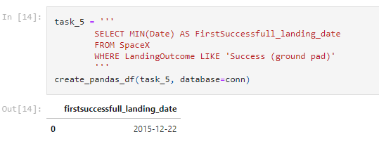
First Successful Ground Landing Date
We observed that the dates of the first successful landing outcome on ground pad was 22nd December 2015

Slide 29
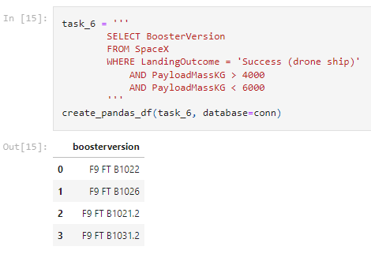
Successful Drone Ship Landing with Payload between 4000 and 6000
We used the WHERE clause to filter for boosters which have successfully landed on drone ship and applied the AND condition to determine successful landing with payload mass greater than 4000 but less than 6000

Slide 30
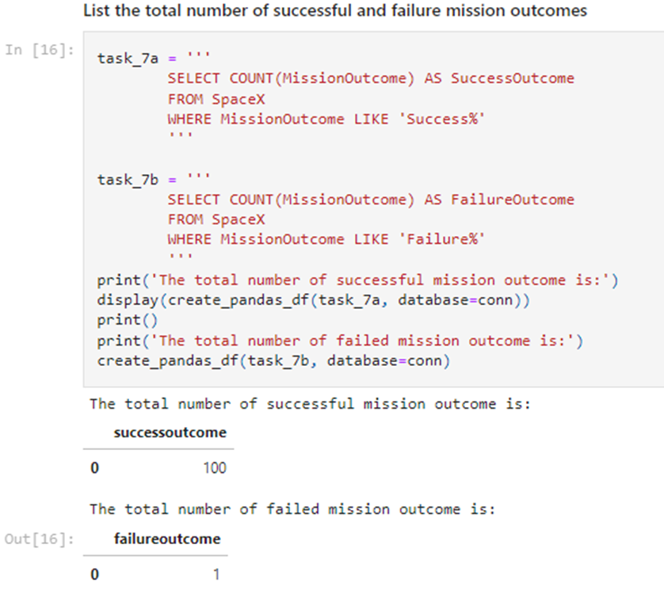
Total Number of Successful and Failure Mission Outcomes
We used wildcard like ‘%’ to filter for WHERE MissionOutcome was a success or a failure.

Slide 31
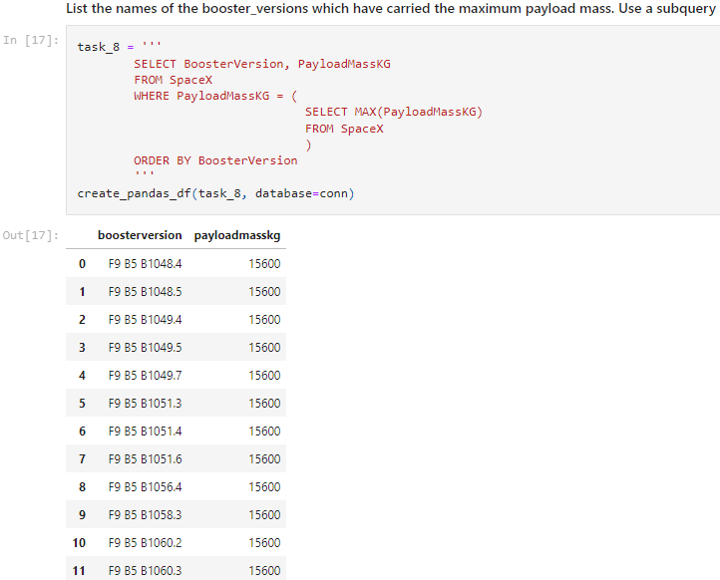
Boosters Carried Maximum Payload
We determined the booster that have carried the maximum payload using a subquery in the WHERE clause and the MAX() function.

Slide 32
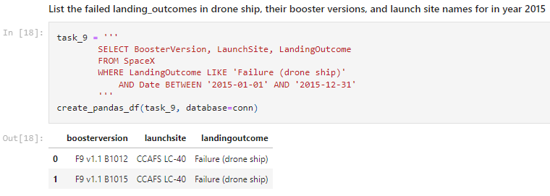
2015 Launch Records
We used a combinations of the WHERE clause, LIKE, AND, and BETWEEN conditions to filter for failed landing outcomes in drone ship, their booster versions, and launch site names for year 2015

Slide 33
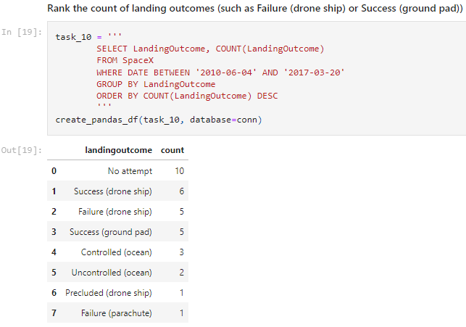
Rank Landing Outcomes Between 2010-06-04 and 2017-03-20
We selected Landing outcomes and the COUNT of landing outcomes from the data and used the WHERE clause to filter for landing outcomes BETWEEN 2010-06-04 to 2010-03-20.
We applied the GROUP BY clause to group the landing outcomes and the ORDER BY clause to order the grouped landing outcome in descending order.

Slide 34
Lauch Sites Proximities Analysis

Slide 35
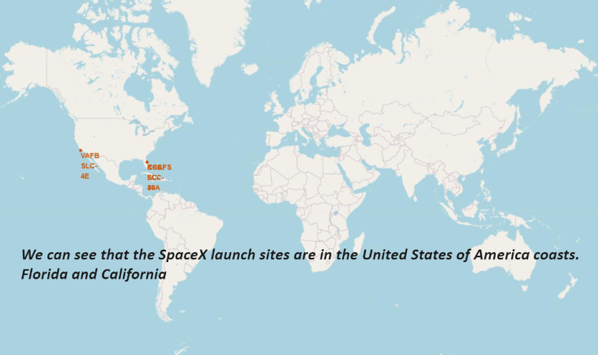
All launch sites global map markers

Slide 36
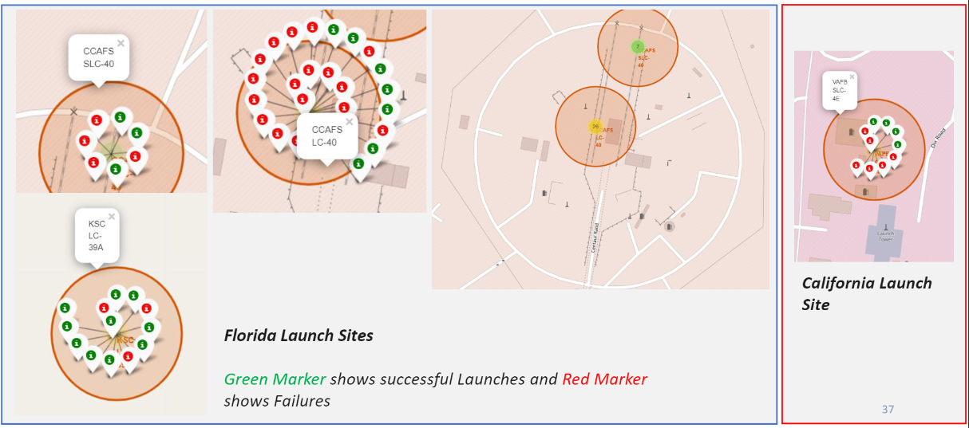
Markers showing launch sites with color labels

Slide 37
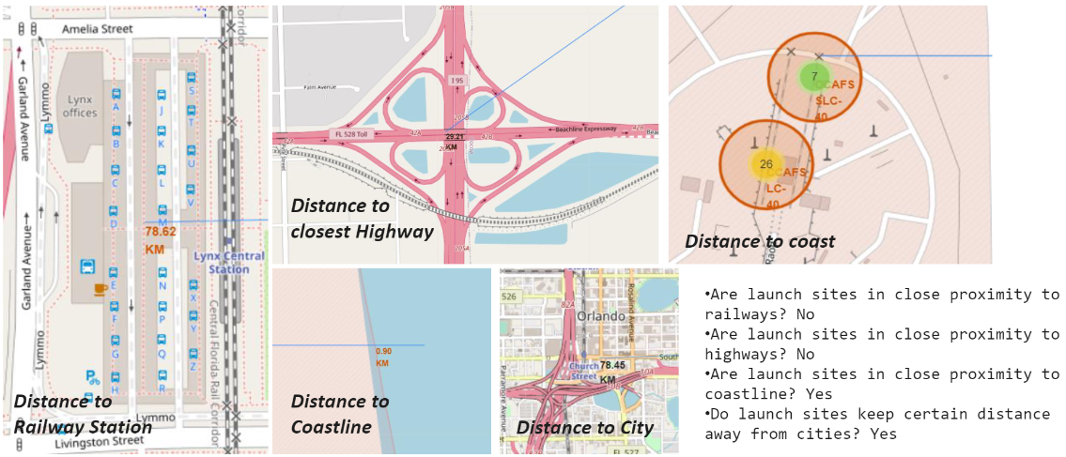
Launch Site distance to landmarks

Slide 38
Building a DashBoard with Plotly Dash

Slide 39
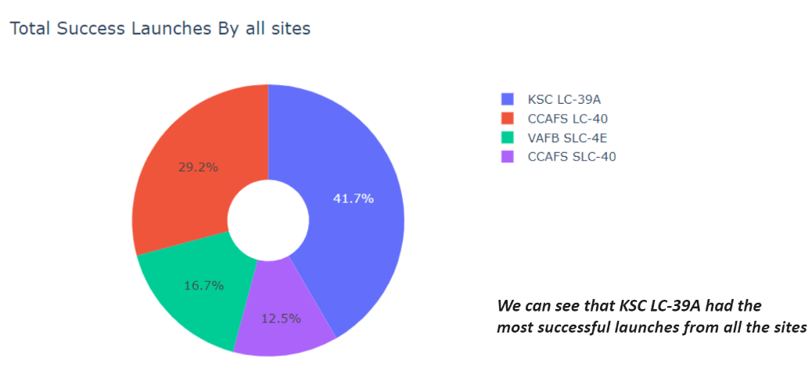
Pie chart showing the success percentage achieved by each launch site

Slide 40
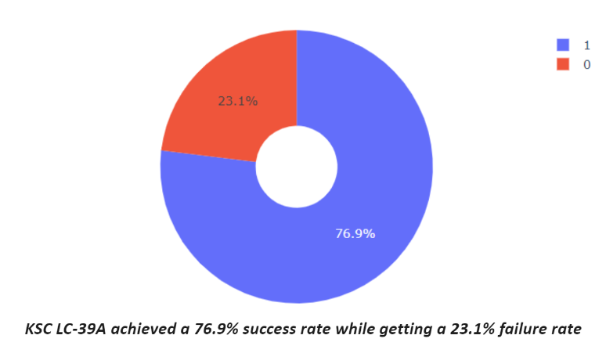
Pie chart showing the Launch site with the highest launch success ratio

Slide 41
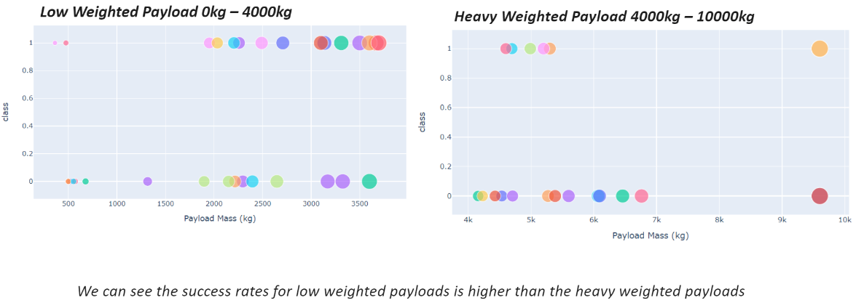
Scatter plot of Payload vs Launch Outcome for all sites, with different payload selected in the range slider

Slide 42
Predictive Analysis

Slide 43
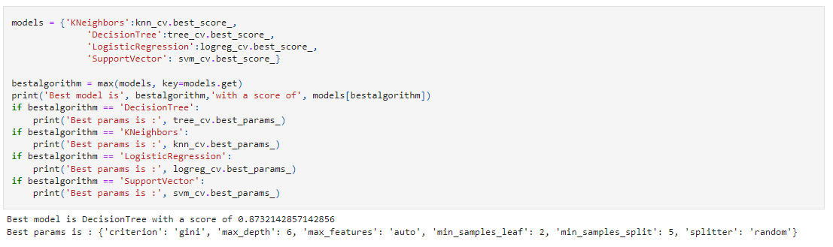
Classification Accuracy
The decision tree classifier is the model with the highest classification accuracy

Slide 44
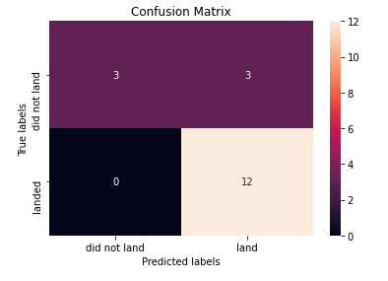
Confusion Matrix
The confusion matrix for the decision tree classifier shows that the classifier can distinguish between the different classes. The major problem is the false positives .i.e., unsuccessful landing marked as successful landing by the classifier.

Slide 45
Conclusion
We can conclude that:
The larger the flight amount at a launch site, the greater the success rate at a launch site.
Launch success rate started to increase in 2013 till 2020.
Orbits ES-L1, GEO, HEO, SSO, VLEO had the most success rate.
KSC LC-39A had the most successful launches of any sites.
The Decision tree classifier is the best machine learning algorithm for this task.

Slide 46
Thank you

